Slide 1
Designing for Web 2.0
Ch. 12

Slide 2
Usability
Summarize
Organize
Write compactly
Don’t be too creative!

Slide 3
Navigation and links
Menus:
Horizontal
Vertical
Flyout
Efficient forms
Proper input elements
Min number of fields
Javascript/PHP for validation

Slide 4
Visual Effects

Slide 5
Scriptaculous overview
Scriptaculous : a JavaScript library, built on top of Prototype, that adds:
visual effects (animation, fade in/out, highlighting)
drag and drop
some DOM enhancements
other stuff (unit testing, etc.)

Slide 6
Downloading and using Scriptaculous
<script src="http://ajax.googleapis.com/ajax/libs/scriptaculous/1.9.0/scriptaculous.js" type="text/javascript"></script> JS
documentation available on their wiki
Scriptaculous Effects Cheat Sheet

Slide 7
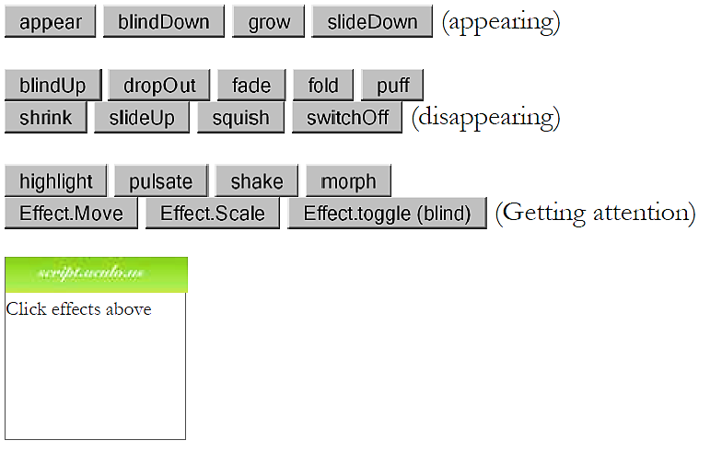
Visual Effects

Slide 8
Adding effects to an element
element.effectName(); // for most effects
// some effects must be run the following way:
new Effect.name(element or id); JS
$("sidebar").shake();
var buttons = $$("results > button");
for (var i = 0; i < buttons.length; i++) {
buttons[i].fade();
} JS
the effect will begin to animate on screen (asynchronously) the moment you call it
six core effects are used to implement all effects on the previous slides:
Effect.Highlight, Effect.Morph, Effect.Move, Effect.Opacity, Effect.Parallel, Effect.Scale

Slide 9
Adding effects to an element
element.effectName(
{
option: value,
option: value,
...
}
); JS
$("my_element").pulsate({
duration: 2.0,
pulses: 2
}); JS
many effects can be customized by passing additional options (note the {})
options (wiki): delay, direction, duration, fps, from, queue, sync, to, transition
Notes:
Q: How would we show two effects in a row on the same element?

Slide 10
Adding effects to an element
$("my_element").fade({
duration: 3.0,
afterFinish: displayMessage
});
function displayMessage(effect) {
alert(effect.element + " is done fading now!");
} JS
all effects have the following events that you can handle:
beforeStart, beforeUpdate, afterUpdate, afterFinish
the afterFinish event fires once the effect is done animating
useful do something to the element (style, remove, etc.) when effect is done

Slide 11
Adding effects to an element
$("my_element").fade({
duration: 3.0,
afterFinish: displayMessage
});
function displayMessage(effect) {
alert(effect.element + " is done fading now!");
} JS
each of these events receives the Effect object as its parameter
its properties: element, options, currentFrame, startOn, finishOn
some effects (e.g. Shrink) are technically "parallel effects", so to access the modified element, you write effect.effects[0].element rather than just effect.element

Slide 12
Drag and drop
Scriptaculous provides several objects for supporting drag-and-drop functionality:
Draggable : an element that can be dragged
Draggables : manages all Draggable objects on the page
Droppables : elements on which a Draggable can be dropped
Sortable : a list of items that can be reordered
Puzzle Game demo

Slide 13
Draggable
new Draggable(element or id,
{ options }
); JS
specifies an element as being able to be dragged
options: handle, revert, snap, zindex, constraint, ghosting, starteffect, reverteffect, endeffect
event options: onStart, onDrag, onEnd
each handler function accepts two parameters: the Draggable object, and the mouse event

Slide 14
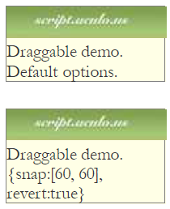
Draggable Example
<div id="draggabledemo1">Draggable demo. Default options.</div>
<div id="draggabledemo2">Draggable demo.
{snap: [40,40], revert: true}</div> HTML
document.observe("dom:loaded", function() {
new Draggable("draggabledemo1");
new Draggable("draggabledemo2", {revert: true, snap: [40, 40]});
}); JS

Slide 15
Draggables
a global helper for accessing/managing all Draggable objects on a page
properties: drags, observers
methods: register, unregister, activate, deactivate, updateDrag, endDrag, keyPress, addObserver, removeObserver, notify

Slide 16
Droppables
Droppables.add(element or id,
{ options }
); JS
To make an element react when a Draggable is dropped onto it, you’ll add it to the Droppables of the page
options: accept, containment, hoverclass, overlap, greedy
event options: onHover, onDrop
each callback accepts three parameters: the Draggable, the Droppable, and the event

Slide 17
Draggable Example
<img id="product1" src="images/shirt.png" alt="shirt" />
<img id="product2" src="images/cup.png" alt="cup" />
<div id="droptarget"></div> HTML
document.observe("dom:loaded", function() {
new Draggable("product1");
new Draggable("product2");
Droppables.add("droptarget", {onDrop: productDrop});
});
function productDrop(drag, drop, event) {
alert("You dropped " + drag.id);
}
JS

Slide 18
Sortable
Sortable.create(element or id of list,
{ options }
); JS
specifies a list (ul, ol) as being able to be dragged into any order
implemented internally using Draggables and Droppables
options: tag, only, overlap, constraint, containment, format, handle, hoverclass, ghosting, dropOnEmpty, scroll, scrollSensitivity, scrollSpeed, tree, treeTag
to make a list un-sortable again, call Sortable.destroy on it

Slide 19
Sortable demo
<ol id="simpsons">
<li id="simpsons_0">Homer</li>
<li id="simpsons_1">Marge</li>
<li id="simpsons_2">Bart</li>
<li id="simpsons_3">Lisa</li>
<li id="simpsons_4">Maggie</li>
</ol> HTML
document.observe("dom:loaded", function() {
Sortable.create("simpsons");
}); JS

Slide 20
Sortable demo
event | description
onChange | when any list item hovers over a new position while dragging
onUpdate | when a list item is dropped into a new position (more useful)
document.observe("dom:loaded", function() {
Sortable.create("simpsons", {
onUpdate: listUpdate
});
}); JS
Notes:
onChange handler function receives the dragging element as its parameter
onUpdate handler function receives the list as its parameter

Slide 21
Sortable list events example
document.observe("dom:loaded", function() {
Sortable.create("simpsons", {
onUpdate: listUpdate
});
});
function listUpdate(list) {
// can do anything I want here; effects, an Ajax request, etc.
list.shake();
} JS

Slide 22
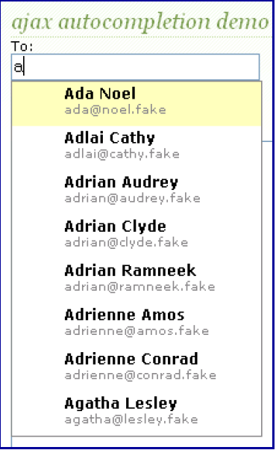
Auto-completing text fields
Scriptaculous offers ways to make a text box that auto-completes based on prefix strings:
Autocompleter.Local : auto-completes from an array of choices
Ajax.Autocompleter : fetches and displays list of choices using Ajax

Slide 23
Using Autocompleter.Local
new Autocompleter.Local(
element or id of text box,
element or id of div to show completions,
array of choices,
{ options }
); JS
you must create an (initially empty) div to store the auto-completion matches
it will be inserted as a ul that you can style with CSS
the user can select items by pressing Up/Down arrows; selected item is given a class of selected
pass the choices as an array of strings
pass any extra options as a fourth parameter between { }
options: choices, partialSearch, fullSearch, partialChars, ignoreCase

Slide 24
Using Autocompleter.Local
<input id="bands70s" size="40" type="text" />
<div id="bandlistarea"></div> HTML
document.observe("dom:loaded", function() {
new Autocompleter.Local(
"bands70s",
"bandlistarea",
["ABBA", "AC/DC", "Aerosmith", "America", "Bay City Rollers", ...],
{}
);
}); JS

Slide 25
Using Autocompleter.Local
<input id="bands70s" size="40" type="text" />
<div id="bandlistarea"></div> HTML
#bandlistarea {
border: 2px solid gray;
}
/* 'selected' class is given to the autocomplete item currently chosen */
#bandlistarea .selected {
background-color: pink;
} CSS

Slide 26
Using Ajax.Autocompleter
new Ajax.Autocompleter(
element or id of text box,
element or id of div to show completions,
url,
{ options }
); JS
when you have too many choices to hold them all in an array, you can instead fetch subsets of choices from the server using Ajax
instead of passing choices as an array, pass a URL from which to fetch them
the choices are sent back from the server as an HTML ul with li elements in it
options: paramName, tokens, frequency, minChars, indicator, updateElement, afterUpdateElement, callback, parameters

Slide 27
Playing sounds (API)
method | description
Sound.play("url"); | plays a sound/music file
Sound.disable(); | stops future sounds from playing (doesn't mute any sound in progress)
Sound.enable(); | re-enables sounds to be playable after a call to Sound.disable()
Sound.play("music/java_rap.mp3");
Sound.play("music/wazzaaaaaap.wav"); PHP
to silence a sound playing in progress, use Sound.play('', {replace: true});
cannot play sounds from a local computer (must be uploaded to a web site)

Slide 28
Ajax.InPlaceEditor
new Ajax.InPlaceEditor(element or id,
url,
{ options }
); JS
options: okButton, okText, cancelLink, cancelText, savingText, clickToEditText, formId, externalControl, rows, onComplete, onFailure, cols, size, highlightcolor, highlightendcolor, formClassName, hoverClassName, loadTextURL, loadingText, callback, submitOnBlur, ajaxOptions
event options: onEnterHover, onLeaveHover, onEnterEditMode, onLeaveEditMode

Slide 29
Ajax.InPlaceEditor
new Ajax.InPlaceCollectionEditor(element or id,
url,
{
collection: array of choices,
options
}
); JS
a variation of Ajax.InPlaceEditor that gives a collection of choices
requires collection option whose value is an array of strings to choose from
all other options are the same as Ajax.InPlaceEditor

Slide 30
Ajax.InPlaceEditor
slider control:
new Control.Slider("id of knob", "id of track", {options}); JS
Builder - convenience class to replace document.createElement:
var img = Builder.node("img", {
src: "images/lolcat.jpg",
width: 100, height: 100,
alt: "I can haz Scriptaculous?"
});
$("main").appendChild(img); JS
Tabbed UIs

