Slide 1
Server side basics

Slide 2
URLs and web servers
http://server/path/file
Usually when you type a URL in your browser:
Your computer looks up the server's IP address using DNS
Your browser connects to that IP address and requests the given file
The web server software (e.g. Apache) grabs that file from the server's local file system
The server sends back its contents to you

Slide 3
URLs and web servers (cont.)
Apache, Websphere
SW(Java Servlets, XML Files)
Web/Application Server
Database

Slide 4
URLs and web servers (cont.)
http://www.facebook.com/home.php
Some URLs actually specify programs that the web server should run, and then send their output back to you as the result:
The above URL tells the server facebook.com to run the program home.php and send back its output

Slide 5
Server-Side web programming
Server-side pages are programs written using one of many web programming languages/frameworks
examples: PHP, Java/JSP, Ruby on Rails, ASP.NET, Python, Perl

Slide 6
Server-Side web programming (cont.)
Also called server side scripting:
Dynamically edit, change or add any content to a Web page
Respond to user queries or data submitted from HTML forms
Access any data or databases and return the results to a browser
Customize a Web page to make it more useful for individual users
Provide security since your server code cannot be viewed from a browser

Slide 7
Server-Side web programming (cont.)
Web server:
contains software that allows it to run server side programs
sends back their output as responses to web requests
Each language/framework has its pros and cons
we use PHP

Slide 8
What is PHP?
PHP stands for "PHP Hypertext Preprocessor"
Server-side scripting language
Used to make web pages dynamic:
provide different content depending on context
interface with other services: database, e-mail, etc.
authenticate users
process form information
PHP code can be embedded in XHTML code

Slide 9
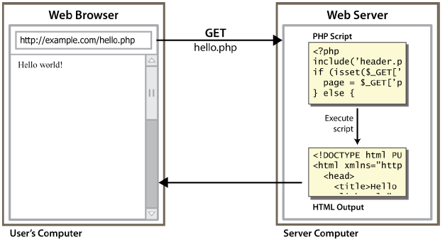
Lifecycle of a PHP web request
Hello.php
Hello world!
User’s computer
Server computer
Notes:
browser requests a .html file (static content): server just sends that file
browser requests a .php file (dynamic content): server reads it, runs any script code inside
it, then sends result across the network
script produces output that becomes the response sent back

Slide 10
Why PHP?
Free and open source
Compatible
as of November 2006, there were more than 19 million websites (domain names) using PHP.
Simple
Notes:
Interpreted, not compiled. Procedural, not OO. Not standalone. Relaxed syntax: fewer, looser data types

Slide 11
Hello World!
<?php
print "Hello, world!";
?> PHP
Hello world!
output
Notes:
block or file of PHP code begins with <?php and ends with ?>
PHP statements, function declarations, etc. appear between these endpoints

Slide 12
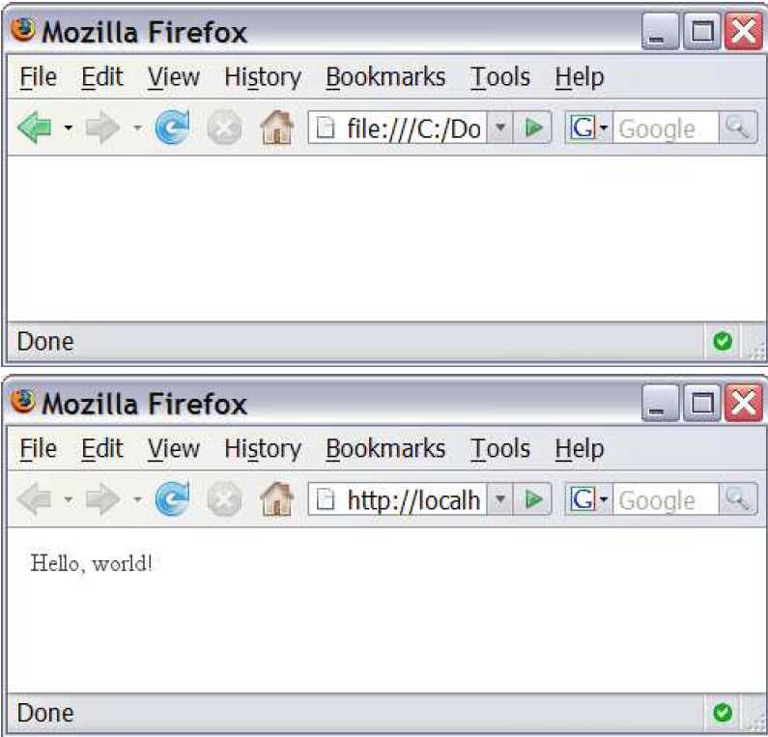
Viewing PHP output
Hello world!
Notes:
you can't view your .php page on your local hard drive; you'll either see nothing or see the
PHP source code
if you upload the file to a PHP-enabled web server, requesting the .php file will run the
program and send you back its output

Slide 13
PHP Basic Syntax

Slide 14
PHP syntax template
HTML content
<?php
PHP code
?>
HTML content
<?php
PHP code
?>
HTML content ... PHP
Contents of a .php file between <?php and ?> are executed as PHP code
All other contents are output as pure HTML
We can switch back and forth between HTML and PHP "modes"
Notes:
Mode switchers

Slide 15
Console output: print
print "text"; PHP
print "Hello, World!\n";
print "Escape \"chars\" are the SAME as in Java!\n";
print "You can have
line breaks in a string.";
print 'A string can use "single-quotes". It\'s cool!'; PHP
Hello world! Escape "chars" are the SAME as in Java! You can have line breaks in a string. A string can use "single-quotes". It's cool!
output
Notes:
some PHP programmers use the equivalent echo instead of print
What is weird with this slide? \n has no effect, no line change

Slide 16
Variables
$name = expression; PHP
$user_name = “mundruid78";
$age = 16;
$drinking_age = $age + 5;
$this_class_rocks = TRUE; PHP
names are case sensitive
names always begin with $, on both declaration and usage
always implicitly declared by assignment (type is not written)
a loosely typed language (like JavaScript or Python)
Notes:
names are case sensitive; separate multiple words with _

Slide 17
Variables
basic types: int, float, boolean, string, array, object, NULL
test type of variable with is_type functions, e.g. is_string
gettype function returns a variable's type as a string
PHP converts between types automatically in many cases:
string → int auto-conversion on +
int → float auto-conversion on /
type-cast with (type):
$age = (int) "21";

Slide 18
Arithmetic operators
+ - * / % . ++ --
= += -= *= /= %= .=
many operators auto-convert types: 5 + "7" is 12

Slide 19
Comments
# single-line comment
// single-line comment
/*
multi-line comment
*/ PHP
like Java, but # is also allowed
a lot of PHP code uses # comments instead of //

Slide 20
String Type
$favorite_food = "Ethiopian";
print $favorite_food[2];
$favorite_food = $favorite_food . " cuisine";
print $favorite_food; PHP
zero-based indexing using bracket notation
there is no char type; each letter is itself a String
string concatenation operator is . (period), not +
5 + "2 turtle doves" === 7
5 . "2 turtle doves" === "52 turtle doves"
can be specified with "" or ''

Slide 21
String Functions
# index 0123456789012345
$name = "Stefanie Hatcher";
$length = strlen($name);
$cmp = strcmp($name, "Brian Le");
$index = strpos($name, "e");
$first = substr($name, 9, 5);
$name = strtoupper($name); PHP

Slide 22
String Functions (cont.)
Name | Java Equivalent
strlen | length
strpos | indexOf
substr | substring
strtolower, strtoupper | toLowerCase, toUpperCase
trim | trim
explode, implode | split, join
strcmp | compareTo

Slide 23
Interpreted Strings
$age = 16;
print "You are " . $age . " years old.\n";
print "You are $age years old.\n"; # You are 16 years old. PHP
strings inside " " are interpreted
variables that appear inside them will have their values inserted into the string
strings inside ' ' are not interpreted:
print ' You are $age years old.\n '; # You are $age years old. \n PHP

Slide 24
Interpreted Strings (cont.)
print "Today is your $ageth birthday.\n"; # $ageth not found
print "Today is your {$age}th birthday.\n"; PHP
if necessary to avoid ambiguity, can enclose variable in {}

Slide 25
Interpreted Strings (cont.)
$name = “Xenia";
$name = NULL;
if (isset($name)) {
print "This line isn't going to be reached.\n";
} PHP
a variable is NULL if
it has not been set to any value (undefined variables)
it has been assigned the constant NULL
it has been deleted using the unset function
can test if a variable is NULL using the isset function
NULL prints as an empty string (no output)

Slide 26
for loop (same as Java)
for (initialization; condition; update) {
statements;
} PHP
for ($i = 0; $i < 10; $i++) {
print "$i squared is " . $i * $i . ".\n";
} PHP

Slide 27
bool (Boolean) type
$feels_like_summer = FALSE;
$php_is_great = TRUE;
$student_count = 7;
$nonzero = (bool) $student_count; # TRUE PHP
the following values are considered to be FALSE (all others are TRUE):
0 and 0.0 (but NOT 0.00 or 0.000)
"", "0", and NULL (includes unset variables)
arrays with 0 elements
FALSE prints as an empty string (no output); TRUE prints as a 1
Notes:
can cast to boolean using (bool)
TRUE and FALSE keywords are case insensitive

Slide 28
if/else statement
if (condition) {
statements;
} elseif (condition) {
statements;
} else {
statements;
} PHP
Notes:
NOTE: although elseif keyword is much more common, else if is also supported

Slide 29
while loop (same as Java)
while (condition) {
statements;
} PHP
do {
statements;
} while (condition); PHP
Notes:
break and continue keywords also behave as in Java

Slide 30
Math operations
$a = 3;
$b = 4;
$c = sqrt(pow($a, 2) + pow($b, 2));
PHP
math functions
abs | ceil | cos | floor | log | log10 | max
min | pow | rand | round | sin | sqrt | tan
math constants
M_PI | M_E | M_LN2
Notes:
break and continue keywords also behave as in Java

Slide 31
Int and Float Types
$a = 7 / 2; # float: 3.5
$b = (int) $a; # int: 3
$c = round($a); # float: 4.0
$d = "123"; # string: "123"
$e = (int) $d; # int: 123 PHP
int for integers and float for reals
division between two int values can produce a float

Slide 32
PHP exercise 1
For your first PHP exercise, echo the following statement to the browser:
“Twinkle, Twinkle little star.”
Next, create two variables, one for the word “Twinkle” and one for the word “star”. Echo the statement to the browser, this time substituting the variables for the relevant words. Change the value of each variable to whatever you like, and echo the statement a third time. Remember to include code to show your statements on different lines.

Slide 33
PHP exercise 2
PHP includes all the standard arithmetic operators. For this PHP exercise, you will use them along with variables to print equations to the browser. In your script, create the following variables: $x=10; $y=7;
Write code to print out the following:
10 + 7 = 17 10 - 7 = 3 10 * 7 = 70 10 / 7 = 1.4285714285714 10 % 7 = 3
Use numbers only in the above variable assignments, not in the echo statements.

Slide 34
PHP exercise 3
Arithmetic-assignment operators perform an arithmetic operation on the variable at the same time as assigning a new value. For this PHP exercise, write a script to reproduce the output below. Manipulate only one variable using no simple arithmetic operators to produce the values given in the statements.
Hint: In the script each statement ends with "Value is now $variable."
Value is now 8. Add 2. Value is now 10. Subtract 4. Value is now 6. Multiply by 5. Value is now 30. Divide by 3. Value is now 10. Increment value by one. Value is now 11. Decrement value by one. Value is now 10.

Slide 35
PHP exercise 4
When you are writing scripts, you will often need to see exactly what is inside your variables. For this PHP exercise, think of the ways you can do that, then write a script that outputs the following, using the echo statement only for line breaks.
string(5) "Harry" Harry int(28) NULL

Slide 36
PHP exercise 5
For this PHP exercise, write a script using the following variable: $around="around";
Single quotes and double quotes don't work the same way in PHP. Using single quotes (' ') and the concatenation operator, echo the following to the browser, using the variable you created: What goes around, comes around.

Slide 37
PHP exercise 5
In this PHP exercise, you will use a conditional statement to determine what gets printed to the browser. Write a script that gets the current month and prints one of the following responses, depending on whether it's August or not:
It's August, so it's really hot. Not August, so at least not in the peak of the heat.
Hint: the function to get the current month is 'date('F', time())' for the month's full name.

Slide 38
PHP exercise 6
Loops are very useful in creating lists and tables. In this PHP exercise, you will use a loop to create a list of equations for squares.
Using a for loop, write a script that will send to the browser a list of squares for the numbers 1-12. Use the format, "1 * 1 = 1", and be sure to include code to print each formula on a different line.

Slide 39
PHP exercise 7
HTML tables involve a lot of repetitive coding - a perfect place to use for loops. You can do even more if you nest the for loops.
In this PHP exercise, use two for loops, one nested inside another. Create the following multiplication table:
1 | 2 | 3 | 4 | 5 | 6 | 7
2 | 4 | 6 | 8 | 10 | 12 | 14
3 | 6 | 9 | 12 | 15 | 18 | 21
4 | 8 | 12 | 16 | 20 | 24 | 28
5 | 10 | 15 | 20 | 25 | 30 | 35
6 | 12 | 18 | 24 | 30 | 36 | 42
7 | 14 | 21 | 28 | 35 | 42 | 49

