Slide 1
CS 380 Web Programming
Instructor: Xenia Mountrouidou

Slide 2
Who am I?
Dr. X
PhD at North Carolina State University
Worked for IBM
Post doc at College of William and Mary
Scuba diver, manga comics collector, science fiction reader.

Slide 3
Course Objectives
At the end of this class you will be able to:
Design and implement a professional website
Author web pages using HTML
Make stylistic decisions with CSS
Create interactive websites with JavaScript and jQuery
Enhance interactive websites with AJAX and XML
Use PHP for server programming

Slide 4
Course Objectives (cont.)
At the end of this class you will be able to:
Understand the client-server programming model and apply this to your designs
Create your own web programming portfolio
Speak the web programming lingo
Have fun with web programming!

Slide 5
Why did you take CS 380?

Slide 6
Why do you need CS 380?
Professional webpage to demonstrate your portfolio, interests etc.
Software development:
Middleware
Web development
Cloud computing

Slide 7
Lectures
We meet at 14:00-15:15, every Mon/Wed, at Merritt Penticoff Science Bld, Room 116A
Check the schedule in the class webpage
Read the syllabus and policies carefully
Reading and labs will be posted online

Slide 8
Lectures
Lectures will be interactive. This means:
You will need to study the new material before every lecture (slides, book, and online material)
We will have a lab on every lecture, so you will need to code in almost every lecture
You will post your questions on the discussion board before each lecture. If you do not post any questions, I assume you have understood everything. Therefore…
You may be called in class to explain the material to your classmates

Slide 9
How to get help
Join my office hours: Mon. 3:30-5:30 pm, Tues./Fri. 1-3 pm at Merritt Penticoff 203
Or set an appointment with me via e-mail
Use the textbook:
“Web Programming Step by Step”
by Marty Stepp, Jessica Miller,
Victoria Kirst

Slide 10
Office hours and help-My schedule
 | Monday | Tuesday | Wednesday | Thursday | Friday
8:00 am | CS150 prep | Research | CS150 prep | Research | CS150 prep
:30
9:00 am | CS150 – 11 lecture |  | CS150 – 11 lecture |  | CS150 – 11 lecture
:30 |  | Independent study
10:00 am | CS150 – 01H lecture |  | CS150 – 01H lecture |  | CS150 – 01H lecture
:30
11:00 am | CS150 – 05F lecture |  | CS150 – 05F lecture |  | CS150 – 05F lecture
:30 |  | Research
12:00 am | Division Meeting | Lunch | Lunch | Lunch | Lunch
:30
1:00 pm | CS 380 prep | Office Hours | CS 380 prep | CS340 prep | Office Hours
:30
2:00 pm | CS 380 lecture |  | CS 380 lecture
:30
3:00 pm |  | CS 340 lecture |  | CS 340 lecture | Programming Competition Prep
:30 | Office Hours |  | Faculty Assembly
4:00 pm |  |  |  |  | RCSS
:30 |  |  | RCSS
5:00 pm
:30
We can meet during my office hours OR set an appointment during the white time slots

Slide 11
Grading
Quizzes | 5%
Project | 30%
Homework | 40%
Final exam | 25%
Total | 100%
Homework and Programming projects will be posted online on the class webpage

Slide 12
Programming Project
You can start working on this from the first week of the class
Design and implementation of a professional website:
Professional Style
Interactive
I will post topics: mostly websites needed by faculty and staff in our school
You can complete the project in teams of two

Slide 13
Programming Project
Your project should have five out of the following features (choose and document these):
1. Use a Server-Side Framework - use a technology other than HTML/CSS on the server.
2. AJAX - use AJAX to turn your web pages into dynamic web applications.
3. Web Service - use an external web service, mashed up with your own application to create something even better.

Slide 14
Programming Project
4. Design & Evaluate - think carefully about how users will use your site, design a great interface, and evaluate it with real people.
5. Go Mobile - create a version of your project designed to go mobile.
6. Server-Side Processing - do processing on the server to prepare for user requests in advance.
7. Multimedia – use sound or video to enhance the user experience.

Slide 15
Homework
It will involve:
Applying what we learned in class
Clean design and coding
Clear documentation
Homework will be completed individually

Slide 16
Policies
Cheating means “submitting, without proper attribution, any computer code that is directly traceable to the computer code written by another person.”
Or even better:
“Any form of cheating, including concealed notes during exams, copying or allowing others to copy from an exam, students substituting for one another in exams, submission of another person’s work for evaluation, preparing work for another person’s submission, unauthorized collaboration on an assignment, submission of the same or substantially similar work for two courses without the permission of the professors. Plagiarism is a form of Academic Misconduct that involves taking either direct quotes or slightly altered, paraphrased material from a source without proper citations and thereby failing to credit the original author. Cutting and pasting from any source including the Internet, as well as purchasing papers, are forms of plagiarism.”
I give students a failing homework grade for any cheating.
A second cheating attempt will be escalated to the chair of our Division.

Slide 17
Policies
You may discuss homework problems with classmates, after you have made a serious effort in trying the homework on your own.
You can use ideas from the literature (with proper citation).
You can use anything from the textbooks/notes.
The code you submit must be written completely by you.

Slide 18
Policies
Read the collaboration policy carefully.
Late policy:
5% is reduced by every day the homework is late
Notes:
I will use software to find if there is illegal collaboration

Slide 19
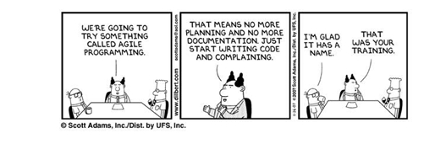
Principles of Pair Programming

Slide 20
Principles of Pair Programming
All I Really Need to Know about pair programming I Learned in Kindergarten
Share everything.
Play fair.
Don’t hit people.
Put things back where you found them.
Clean up your own mess.
Don’t take things that aren’t yours.
Say you’re sorry when you hurt somebody.

Slide 21
Principles of Pair Programming
Wash your hands before you eat.
Flush.
Warm cookies and cold milk are good for you.
Live a balanced life – learn some and think some and draw and paint and sing and
Dance and play and work every day some.
Take a nap every afternoon.
When you go out into the world, watch out for traffic, hold hands and stick together.
Be aware of wonder.

Slide 22
Professional Portfolio
A collection of projects you implemented for a class or for fun.
Examples:
http://lesterchan.net/portfolio/programming/
http://michaelmohammed.com/portfolio.html
http://www.quality-web-programming.com/web-programming-portfolio.php
http://www.energyscripts.com/Portfolio/web_programming.html

Slide 23
The INTERNET… and a bit of history

Slide 24
What is the internet?
A “series of tubes”
How many Internets are out there?
Is Google one of them?
Notes:
Computer networks interconnected

Slide 25
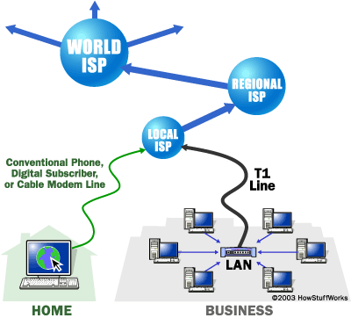
What is the internet?
A collection of computer networks that use a protocol to exchange data
Is the World Wide Web (WWW) and the internet the same?
Notes:
the Web is the collection of web sites and pages around the world; the Internet is larger and also
includes other services such as email, chat, online games, etc.

Slide 26
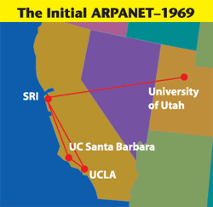
Brief history
Began as a US Department of Defense
network called ARPANET (1960s-70s)
Packet switching (in the 60s)
E-mail is born on 1971
TCP/IP beginning on 1974 (Vinton Cerf)
USENET (1979)
By 1987: Internet includes
nearly 30,000 hosts
Notes:
The first ARPANET link was established between the University of California, Los Angeles and the Stanford Research Institute on 22:30 hours on October 29, 1969
Store and forward, i.e. packet switching
Usenet is a world-wide distributed discussion system. It consists of a set of "newsgroups" with names that are classified hierarchically by subject. "Articles" or "messages" are "posted" to these newsgroups by people on computers with the appropriate software -- these articles are then broadcast to other interconnected computer systems via a wide variety of networks. Some newsgroups are "moderated"; in these newsgroups, the articles are first sent to a moderator for approval before appearing in the newsgroup. Usenet is available on a wide variety of computer systems and networks, but the bulk of modern Usenet traffic is transported over either the Internet or UUCP.

Slide 27
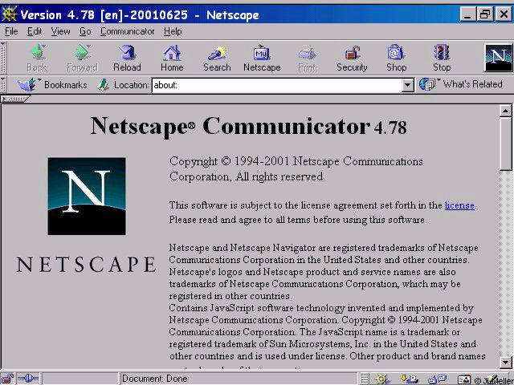
Brief history (cont.)
WWW created in 1989-91 by Tim Berners-Lee
Popular web browsers released:
Netscape 1994
IE 1995
Amazon.com opens in 1995
Google January 1996
Wikipedia launched in 2001
MySpace opens in 2003
Facebook February 2004

Slide 28
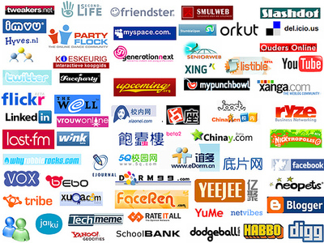
Wikipedia launched in 2001
MySpace opens in 2003
Facebook February 2004
Notes:
Which of these do you recognize?

Slide 29
The future of the internet?

Slide 30
Key aspects of the internet
Sub-networks are independent
Computers can dynamically join and leave the network
Built on open standards
Lack of centralized control (mostly)
Everyone can use it with simple, commonly available software
Notes:
; anyone can create a new internet device

Slide 31
People and organizations
Internet Engineering Task Force (IETF): internet protocol standards
Internet Corporation for Assigned Names and Numbers (ICANN): decides top-level domain names
World Wide Web Consortium (W3C): web standards

Slide 32
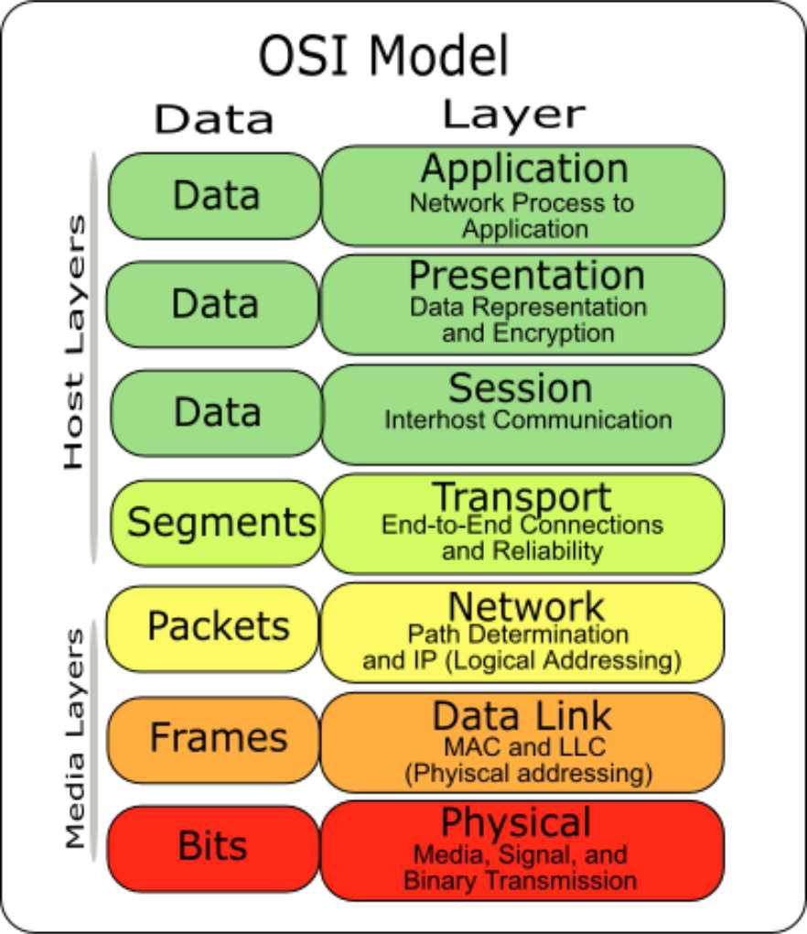
Layered architecture
Notes:
physical layer : devices such as ethernet, coaxial cables,
fiber-optic lines, modems
data link layer : basic hardware protocols (ethernet, wifi,
DSL PPP)
network / internet layer : basic software protocol (IP), switching and routing, virtual circuits
transport layer : adds reliability to network layer (TCP,
UDP)
Session: This layer establishes, manages and terminates connections between This layer establishes, manages and terminates connections between applications
Presentation: This layer provides independence from differences in data representation (e.g., encryption) by translating from application to network format, and vice versa.
application layer : implements specific communication for each kind of program (HTTP, POP3/IMAP, SSH, FTP)

Slide 33
Internet Protocol (IP)
Simple protocol for data exchange between computers
IP Addresses:
32-bit for IPv5
128-bit for IPv6
Notes:
find out your internet IP address: whatismyip.com find out your local IP address: in a terminal, type: ipconfig (Windows) or ifconfig (Mac/Linux
Routers forward data based on tables
IP is simple: no corruption check, no sequencing, no data loss assurance, no duplication

Slide 34
Transmission Control Protocol (TCP)
Adds multiplexing, guaranteed message delivery on top of IP
Multiplexing: multiple programs using the same IP address
Port: a number given to each program or service
port 80: web browser (port 443 for secure browsing)
port 25: email
port 22: ssh
Some programs (games, streaming media programs) use simpler UDP protocol instead of TCP
Notes:
ACK for guarantee data delivery, re-transmit, validity checking
Multiple programs and services share the same internet connection
Freedom from reliability worries
UDP: unreliable but faster

Slide 35
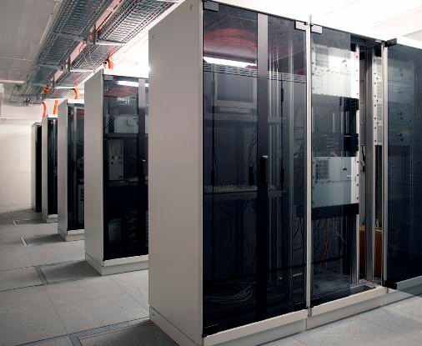
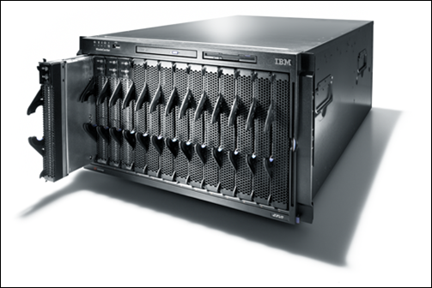
Web Servers
Web server: software that listens for web page requests
Apache
Microsoft Internet
Information Server (IIS)
Notes:
Normal computers, just more powerful
They run specialized SW

Slide 36
Application Server
Software framework that provides an environment where applications can run
Apache
Glassfish
WebSphere
WebLogic
Notes:
Taking a big step back, a Web server serves pages for viewing in a Web browser, while an application server provides methods that client applications can call. A little more precisely, you can say that:
A Web server exclusively handles HTTP requests, whereas an application server serves business logic to application programs through any number of protocols.

Slide 37
Web Browser
Web browser: fetches/displays documents from web servers
Mozilla Firefox
Microsoft Internet Explorer (IE)
Apple Safari
Google Chrome
Opera
Notes:
Explorer pain

Slide 38
Domain Name Server (DNS)
Set of servers that map written names to IP addresses
Example: ju.edu → 204.29.160.73
Many systems maintain a local cache called a hosts file
Windows: C:\Windows\system32\drivers\etc\hosts
Mac: /private/etc/hosts
Linux: /etc/hosts
Notes:
What happens when you have connection but cannot download a webpage??
Mapping between numbers and human readable addresses
Top level domains: .com, .org, countries

Slide 39
Uniform Resource Locator (URL)
Identifier for the location of a document on a web site
Example: http://dept.ju.edu/cs/index.html
Upon entering this URL into the browser, it would:
ask the DNS server for the IP address of dept.ju.edu
connect to that IP address at port 80
ask the server to GET /cs/index.html
display the resulting page on the screen

Slide 40
Hypertext Transport Protocol (HTTP)
Set of commands understood by a web server and sent from a browser
Some HTTP commands (your browser sends these internally):
GET filename : download
POST filename : send a web form response
PUT filename : upload
Exercise: simulate a browser with a terminal window
Notes:
telnet ju.edu
GET index.html
http is stateless

Slide 41
HTTP Error Codes
When something goes wrong, the web server returns a special "error code" number
Common error codes:
Number | Meaning
200 | OK
301-303 | page has moved (permanently or temporarily)
403 | you are forbidden to access this page
404 | page not found
500 | internal server error

Slide 42
Internet Media (“MIME”) types
MIME type | file extension
text/html | .html
text/plain | .txt
image/gif | .gif
image/jpeg | .jpg
video/quicktime | .mov
application/octet-stream | .exe
Notes:
Sometimes when including resources in a page (style sheet, icon, multimedia object), we specify their type of data

Slide 43
Web Languages
Hypertext Markup Language (HTML): used for writing web pages
Cascading Style Sheets (CSS): stylistic info for web pages
PHP Hypertext Processor (PHP): dynamically create pages on a web server
JavaScript: interactive and programmable web pages

Slide 44
Web Languages(cont.)
Asynchronous JavaScript and XML (Ajax): accessing data for web applications
eXtensible Markup Language (XML): metalanguage for organizing data

